Slide 1

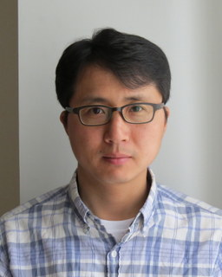


AMP: An Adaptive Multipath TCP for Data Center Networks
Morteza Kheirkhah
University College London, UK
Myungjin Lee
University of Edinburgh, UK
IFIP Networking 2019

Slide 2

Data centre networks (DCN)
Various applications with diverse communication patterns and requirements
  Some apps are bandwidth hungry (online file storage); some others are latency sensitive (online search)
Short flow dominance
  Majority of network flows are short-lived with deadline in their flow completion time (FCT). These flows typically cause sudden burst in traffic
  Majority of data volumes come from a few (long) flows
It is challenging to provide high throughput and low latency communications in highly dynamic network conditions
Notes:
DCNs typically host various apps…
Another key feature is the short flow dominance...
Short flows typically cause sudden burst in network traffic due to their traffic patterns that are often bursty
So DCs are very important … ☺
Bandwidth-hungry applications: 1) video streaming 2) online file storage 3) Virtual Machine (VM) migrations
Latency sensitive: Online search which uses partition aggregate workflow
We are looking at very sensitive network environment
Latency is every where and It Costs you Sales – How to Crush it
http://highscalability.com/latency-everywhere-and-it-costs-you-sales-how-crush-it

Slide 3
Network congestion in DCNs
Transient congestion: Many short flows collide on a link (in a synchronized fashion)
Persistent congestion: a few long flows collide on a link (typically due to poor load-splitting of the ECMP routing)
Notes:
We can categorized network congestion in two broad category: 1) transient congestion 2) persistent congestion
Transient congestion happens when many short flows…
When two or more long flows … collide on their ECMP hashes.. Creating an avoidable congestion
Here is how this happens…
Consequence is that any flows passing that bottleneck link will experience high queuing delay or packet drop probability, and also all the links before and after that bottleneck link would be under utilized

Slide 4


Existing solutions
Transient congestion
DCTCP …
Low latency
Good for mice flows
Persistent congestion
MPTCP …
High throughput
Good for elephant flows
Transient & Persistent
XMP
DCM (our prior work)
Good for all flows
ECN-based multipath schemes seem to provide a good balance between the latency-throughput trade-off
Notes:
Existing solutions for transient congestion is DCTCP, D2TCP
DCTCP -> has been widely used in production datacenters
DCTCP -> it has been designed to minimize flow completion time of short flows by controlling the buffer occupancy of network switches via the ECN signal
MPTCP -> Unlike DCTCP, it has a loss-based congestion control which tends to fully occupy the network buffers
MPTCP -> Improves throughput of long flow
XMP -> Tries to deal with tradeoff between latency-throughput gracefully
DCTCP tries to keep a low buffer occupancy of links, achieving a low FCT for short flows
Single-path transport protocol
MPTCP tends to fully occupy the network buffers, achieving high goodput for long flows
High queueing delays and packet drop probability
XMP tries to deal with the latency-throughput trade-off by exploiting MPTCP and ECN

Slide 5
Problems with ECN-capable variant of MPTCP
TCP Incast
  Well-studied topic for TCP (not really for MPTCP)
Last Hop Unfairness (LHU)
  We are reporting it for the first time
Notes:
Each subflow maintains a separate congestion window
More subflows, more chance of experiencing a retransmission timeout during an incast episode

Slide 6

Problem 1: Incast
MPTCP and its ECN-capable variants are not robust against the Incast problem
  More subflows --> More packets --> Buffer overflow --> Higher chance of RTO in each subflow especially when the congestion window is small
RTO
200ms
S1
SF1
SF2
SF3
200ms
S2
SF1
SF2
SF3
DROP
200ms
S3
SF3
SF2
SF1
S4
SF3
SF2
SF1
Notes:
MPTCP and its ECN-capable variants are not robust against the Incast problem…
Why is that? the problem is very simple, the more subflows is used → the more packets is geneted → as a result the switch buffer can easily overflow → Which implies higher chance of RTO in each subflow especially when the congestion window is small (less than 10 packets)
4 multipath senders -> sending to through a link with eagress buffer size of 9 packets with the droptail discipline
Unfortuantely the droppped packets correspond to a different senders; algrough for each sender the packet get dropped from a subflow but entire MPTCP congestion should wait until this lost packet being recovered

Slide 7
Incast in practice
Better
Experiment setup
MPTCP has 4 subflows
RTT | 20us
Flow size | 128KB
Link rate | 10Gbps
Buffer size | 100pkts
Multipath schemes complete their flows by 1-2 orders of magnitude longer than DCTCP
Notes:
The y-axis is Mean FCT (ms) and it is log-scalled; x-axis is No. of competing flows.
We have DCTCP which is ECN-based and single-path; XMP is ECN-based and multipath; standard MPTCP with loss-based CC.
Multipath schemes has four subflows.
Impact of TCP incast on multipath protocols (XMP and DCM) and DCTCP
Data Center MultiPath (DCM) is another ECN-Capable MPTCP variants that we also proposed in this paper. The idea is to combine MPTCP with DCTCP.

Slide 8
Problem 2: Last Hop Unfairness
Let’s assume:
  Propagation delay is zero
  Marking threshold (K) at switches sets to 4 packets (K=4)
  Minimum congestion window size sets to one packet (cwnd_{min}=1)
Normal situation
Two single-path flows share the link fairly. Each flow generating two packets per RTT on average
Persistent buffer inflation
A new arriving packet always finds the queue size equal to K. Each flow is thus forced to reduce its cwnd to one packet
Last hop unfairness
The multipath flow (S5) with 4 subflows sending four times more packets than single-path flows
The LHU leads to severe unfairness and significantly escalates the likelihood of persistent buffer inflation
Notes:
To explore this problem let’s assume:
PBI: A new arriving… because number of competing flows with minimum cwnd is higher than marking threshold K
LHU: now we can see not only MPTCP cause serious buffer inflation but also it is seriously unfair to competing flows

Slide 9
LHU in practice
Unfair
Experiment setup
8 DCTCP flows competing with one XMP flow
X-axis shows the number of XMP’s subflows in each experiment
Y-axis shows the mean goodput
Fair
As the number of XMP’s subflows increases, the impact of LHU problem increases
Notes:
Imagine having more MPTCP flows competing with 8 DCTCP

Slide 10
Incast vs. LHU (recap)
INCAST
LHU
Marking Threshold (K)
Maximum queue size
DROP

Slide 11
Our solution
Adaptive MultiPath (AMP)
a multipath congestion control algorithm for data center networks

Slide 12
AMP design
Our key observation:
  When all subflows of a multipath flow have the smallest cwnd value (and their packets are ECN-marked), it is a good indicator that the subflows are at the same bottleneck link (facing severe congestion)
Subflow suppression/release algorithms:
  Suppression: AMP deactivates all subflows but one, when the minimum window state across all subflows remains for a small time period (e.g., 2 RTTs)
  Release: AMP reactivates all suspended subflows when it no longer receives ECN-marked packets for some time period (e.g., 8 RTTs)
AMP behaves like a single-path flow once it detects the LHU condition
Notes:
The number of subflows for a multipath flow should not be static
The cwnd values in subflows are a cue for the TCP incast and LHU

Slide 13
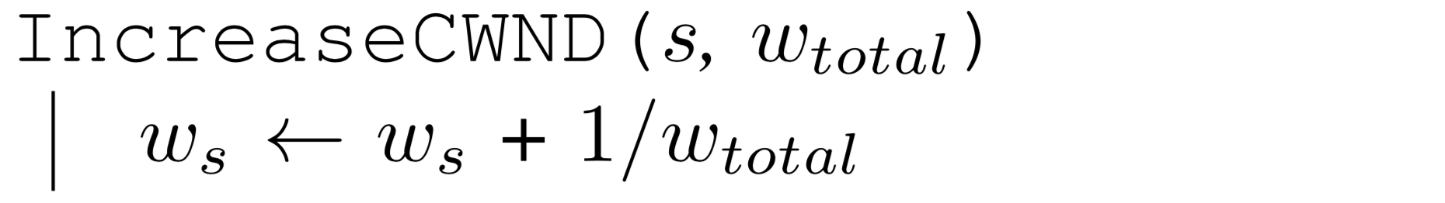
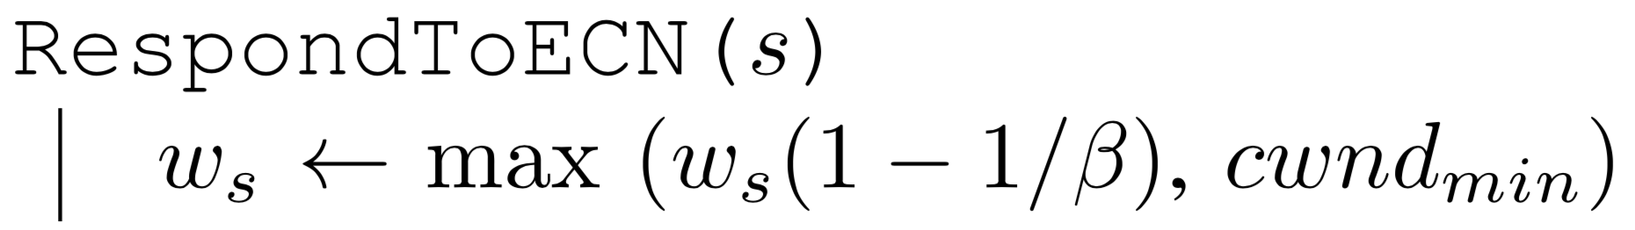
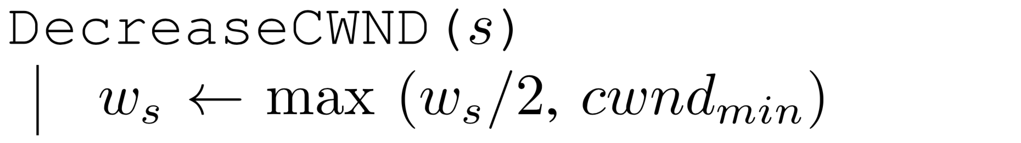
AMP also simplifies congestion control operation
We make a few observations:
  When ECN is used in a DCN, RTT measurements of subflows are unnecessary for updating their cwnd
  DCTCP-like window reduction slows down traffic shifting
AMP’s congestion control algorithm
Notes:
Standard MPTCP is designed to perform well when subflows have different RTTs. Such scenarios do not exist in DCs
ECN with small marking threshold tends to equalize RTTs throughout a DCN
ECN tends to equalize RTTs throughout a DCN when switches react to instant queue length with a small marking threshold.
XMP and DCM also inherit MPTCP’s design principles, one of which targets to address the RTT mismatch issue that can occur when there are paths with high RTT and low loss probability and paths with low RTT and high loss probability. DCNs thus have no paths that cause the RTT mismatch issue.
Traffic shifting times of MPTCP (=4) and DCM

Slide 14
AMP under LHU
No. of multipath flows = 1
No. of subflow = 4
No. of multipath flows = 4
No. of subflow = 4
Better
Better
No LHU
Severe LHU

Slide 15
AMP under Incast
Flow Size of 128KB
Better
AMP can be used for both short and long flows

Slide 16
Summary
Existing multipath congestion control schemes fail to handle:
  The TCP incast problem that causes temporal switch buffer overflow due to synchronized traffic arrival
  The last hop unfairness that causes persistent buffer inflation and serious unfairness
We designed AMP to effectively overcome these problems:
  AMP adaptively switches its operation between a multiple-subflow and single-subflow mode
Notes:
AMP also simplifies congestion control operations:
It increases one segment per RTT across all subflows
Existing solution consider RTT to increase their cwnds
It cuts cwnd by constant factor in response to ECN signals
Unlike DCTCP that dynamically adjust its cwnd based on fraction of marked packets

Slide 17
Source code
As part of AMP project, I have implemented (from scratch) several networking protocols in ns-3.19 including MPTCP, DCM, XMP and DCTCP.
The AMP source code is available publicly from (my GitHub) https://github.com/mkheirkhah

Slide 18
Thank You!

Slide 19
Last Hop Unfairness (cont.)
In reality, persistent buffer inflation (PBI) can be simply triggered by small number of flows sharing a bottleneck link
  (BDP + K) / cwnd_{min}
When BDP=20, K=10, and cwnd_{min} =2, we only need 15 flows to see an episode of PBI
When a MPTCP flow with 8 subflows is present, we may need only 7 more single-path flows to see the LHU problem!
LHU increases the likelihood of buffer overflowing and in turn helps to escalate an incast episode
Notes:
In data center networks:
Bandwidth-delay product is small; e.g. 20-30 packets
ECN marking threshold at switches is small; e.g. 10 pkts
TCP and MPTCP variants set the minimum congestion window size two two packets (cwnd_{min} = 2)
A switch begins ECN-marked all incoming packets when there are BDP + K packets
Let’s assume BDP=20 and K=10, then 30 packets is enough to trigger a switch to mark all incoming packets
Now given TCP and MPTCP variants set the minimum congestion window size (cwnd_{min}) to two packets, BDP + K / cwnd_{min} flows is sufficient to force a switch to mark all incoming packet
Now if one of these flows is MPTCP with 8 subflows, it takes 8 times more bandwidth than other single-path flows.

