Slide 1
MMPTCP: A Multipath Transport Protocol for Data Centres
Morteza Kheirkhah
University of Edinburgh, UK
Ian Wakeman and George Parisis
University of Sussex, UK
IEEE INFOCOM 2016
Notes:
Acknowledge George and Ian Wakeman

Slide 2
Data Centre Importance
Support diverse applications with diverse communication patterns and requirements
  Some apps are bandwidth hungry (online file storage)
  Other apps are latency sensitive (online search)
The DC Performance is directly impacted the revenue of many companies
  Amazon sales dropped by 1% by adding 100ms latency
  Online brokers could lose 4M US dollars per millisecond if they fall 5ms behind their competitors

Slide 3
Data Center Network Properties
Short flow dominance
  99% of flows are short flows (size < 100MB)
  Majority of short flows are query flows with deadline in their flow completion times (size < 1MB – e.g. 50KB)
  90% of total bytes come from long flows (size > 100MB)
Traffic pattern is very bursty
  Bursty traffic pattern is originated from short flows
Low latency and high bandwidth
  Latency is in the order of microsecond (e.g. 100-250μs)
  Minimum link capacity is 1Gbps

Slide 4
Prob 1: Persistent Congestion
Two or more long flows collide on their hashes and end up on the same output port
  Increasing the RTT and packet drop probability
  Inefficient use of network recourses
Long Flow 1
Core
Core
Core
Core
Long Flow 2
Aggr
Aggr
Aggr
Aggr
Aggr
Aggr
Aggr
Aggr
ToR
ToR
ToR
ToR
ToR
ToR
ToR
ToR
½ rate
½ rate
Host
Host
Host
Host
Host
Host
Host
Host

Slide 5
Prob 2: Transient Congestion
One or more long flow(s) collides with several (bursty) short flows
  Increasing the RTT and packet drop probability
  Inefficient use of the network resources
Long Flow
Core
Core
Core
Core
Short Flow
Aggr
Aggr
Aggr
Aggr
Aggr
Aggr
Aggr
Aggr
ToR
ToR
ToR
ToR
ToR
ToR
ToR
ToR
½ rate
Timeout
Host
Host
Host
Host
Host
Host
Host
Host

Slide 6


Existing Solutions
Transient Congestion
DCTCP
(SIGCOMM ’10)
D²TCP
(SIGCOMM ’12)
Good for Mice Flows
Persistent Congestion
MPTCP
(SIGCOMM ’11)
Hedera
(NSDI ’10)
Good for Elephant Flows
No universal solution to these problems

Slide 7
Contribution
Maximum MultiPath TCP (MMPTCP)
  Build on standard MultiPath TCP (MPTCP)
High goodput for long flows
  ~200% increase compared to TCP
Low flow completion time for short flows
  ~10% in mean and ~400% in standard deviation compared to MPTCP
Incremental deployment
  No change into the network and application layers

Slide 8
MPTCP Overview
MPTCP opens multiple subflows at connection startup
Each subflow has its own sequence number space
MPTCP moves its traffic from the most congested path(s) to the least congested one(s)
Core
Core
Core
Core
Aggr
Aggr
Aggr
Aggr
Aggr
Aggr
Aggr
Aggr
ToR
ToR
ToR
ToR
ToR
ToR
ToR
ToR
Host
Host
Host
Host
Host
Host
Host
Host

Slide 9
MPTCP: Good for Long Flows
More subflows -> Better load balancing -> High Goodput

Slide 10

MPTCP: Bad for Short Flows
An entire MPTCP connection needs to wait until SF1 recovers its lost packet via a timeout
SF1
SF2
SF3
SF4
Core
Core
Core
Core
Packet drop
Aggr
Aggr
Aggr
Aggr
ToR
ToR
~200ms
Host
Host
10

Slide 11
MPTCP: Bad for Short Flows
More subflows -> Less pkts per subflow -> More Timeouts

Slide 12
MMPTCP: Good for All Flows
Core
Core
Core
Core
Aggr
Aggr
Aggr
Aggr
ToR
ToR
ToR
ToR
Host
Host
Host
Host

Slide 13
MMPTCP Operates in Two Phases
Starts a connection with one subflow
  Randomises traffic on per-packet basis
  Recovers lost packets over a single sequence space
Opens more subflows when a threshold reaches (e.g. 1MB)
  MPTCP congestion control govern the data transmission
  The initial subflow is deactivated at this point

Slide 14
MMPTCP Key Features
Handles bursty traffic patterns gracefully
Decreases the flow completion time of short flows compared to MPTCP
Increases the throughput of long flows
Incrementally deployable
MMPTCP achieves its goals by exploiting all parallel paths in the data centre faric

Slide 15
Packet Reordering in Phase 1
Spurious retransmissions may occur due to out-of-order packets
  Existing solutions: RR-TCP, Eifel and so on
  Not sufficient for latency sensitive short flows
Our solution
  Increase the dupack threshold based on the number of parallel paths between a src-dst pair
  Perfectly works for VL2 and FatTree

Slide 16
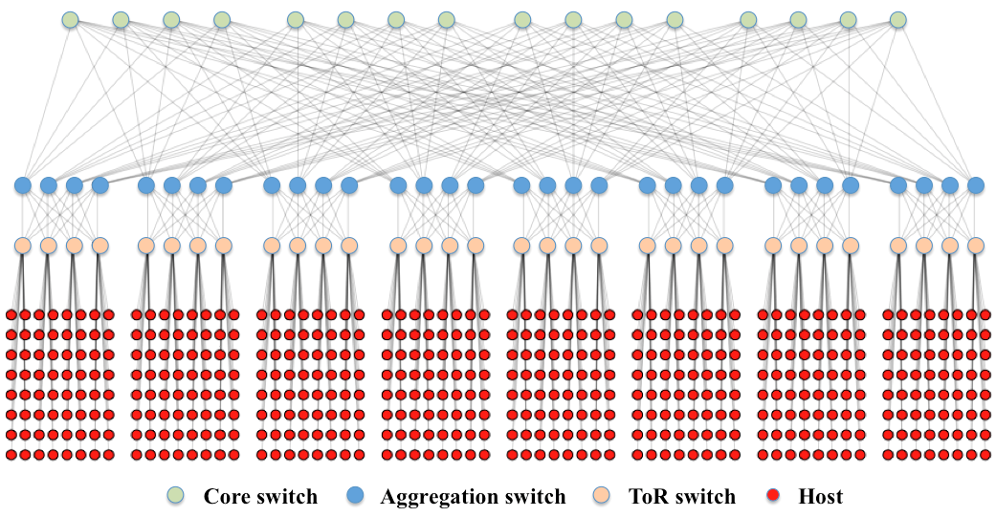
Simulation Setup
A FatTree topology with 4:1 oversubscription ratio (K=8)
A Permutation traffic matrix
1/3 of nodes send continuous traffic (long flows)
2/3 of nodes send short flows based on a Poisson arrival
MMPTCP switching threshold of 100KB
Link rate of 100Mbps and link delay of 20us

Slide 17
Flow Completion Time (FCT)
MPTCP, 8 subflows
Mean FCT: 125ms
Mean Stdev: 425ms
MMPTCP
Mean FCT: 116ms
Mean Stdev: 101ms

Slide 18
Fast ReTx and Timeout
MPTCP, 8 subflows
Mean FCT: 125ms
Mean Stdev: 425ms
MMPTCP
Mean FCT: 116ms
Mean Stdev: 101ms

Slide 19
Hotspot
Hotspots occur for several reasons:
  Contention between traffic flowing from the Internet to data centres (and vice versa)
  Hardware failures or cable faults
Simulation Setup:
  Mean Short flow arrival rate of 2560/sec (Poisson)
  Transport protocols under examination:
    MMPTCP
    MPTCP
    TCP

Slide 20

Hotspot (Results)
Notes:
Add Key

Slide 21
Final Remarks
MMPTCP is an extension of MPTCP
  High burst tolerance
  Low latency for short flows
  High throughput for long flows
  Incremental deployment

Slide 22

Thank You!

