Slide 1
A Reinforcement Learning Algorithm for Cognitive Network Optimiser (CNO) in the 5G-MEDIA Project
Morteza Kheirkhah
University College London

Slide 2
Topics
Machine learning techniques
Reinforcement learning (RL) algorithm
RL vs other ML techniques (e.g. supervised and semi-supervised)
RL with offline vs online learning
RL variants (e.g. A3C and DQN)
Training A3C with parallel agents
Key metrics (learning rate, loss function, and entropy)
CNO Design for UC2(state, action, reward)
Hands-on exercises

Slide 3
Machine learning techniques
Supervised
It needs labeled datasets to train a model
Unsupervised
It does not need labeled datasets, but it needs datasets
Semi-supervised
It works with partially labeled datasets
Reinforcement learning
It does not necessarily need datasets to be trained. It can learn and behave appropriately towards a set of objectives in an online fashion

Slide 4
RL key terminologies
Action (A): All the possible decisions that the agent can take.
State (S): Current situation returned by the environment. Current situation is defined by set of parameters
Reward (R): An immediate return send back from the environment to evaluate the last action
Policy (π): The strategy that the agent employs to determine next action based on the current state.
Value (V): The expected long-term return with discount, as opposed to the short-term reward R. Vπ(s) is defined as the expected long-term return of the current state under policy π.

Slide 5
Reinforcement learning algorithm
An RL agent takes an action (at a particular condition) towards a particular goal, it then receives a reward for it.
This way, the agent tends to adjust its actions (behavior) to achieve a higher reward.
To make choices, the agent relies both on learnings from past feedback and exploration of new tactics (actions) that may present a larger payoff.
Notes:
This implies that the agent’s overall objectives can be reflected in the reward function.

Slide 6
RL vs other ML techniques
Unlike supervised/unsupervised learning algorithms that require diverse datasets, an RL algorithm requires diverse environments to be trained
Exposing a RL algorithm to a large number of conditions in the real environment is a time-consuming process
It is typical to train an RL algorithm in a simulated and emulated environment

Slide 7
RL with offline vs online learning
There are several ways to deploy an RL algorithm in real systems:
You can immediately deploy your algorithm in the real environment and lets your algorithm learn in an online fashion
You can initially train your algorithm offline by simulating real environment and then deploy your trained model in a real system with no more learning
You can initially train your model offline and then deploy it in a real system and continue learning afterwards

Slide 8
RL variants
Asynchronous Advantage Actor-Critic (A3C)*
Tabular Q-Learning*
Deep Q-Network (DQN)
Deep Deterministic Policy Gradient (DDPG)
REINFORCE
State-Action-Reward-State-Action (SARSA)
…

Slide 9
RL variants
Tabular Q-Learning Algorithm:
All possible states and actions are stored in a table
A possible drawback is that the algorithm do not scale well when the state-action space is very large
A solution to the above issue is to decrease the state space by making some simplifications that often translate to unrealistic conditions.
For example, an RL algorithm assumes that the next action can be decided based on current state.
This often results in poor prediction of network condition and in turn wrong action may be selected

Slide 10
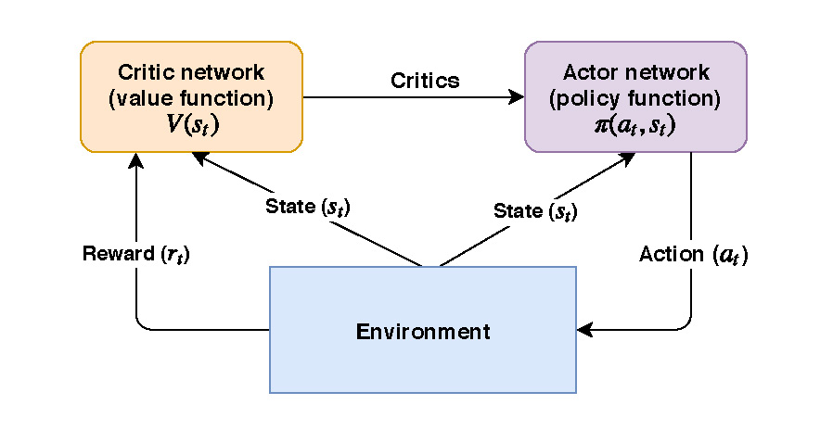
RL variants
Asynchronous Advantage Actor-Critic (A3C):
An reinforcement learning algorithm utilising a neural network rather than the explicit state-action tables
A3C runs two separate neural networks simultaneously: actor and critic networks
The critic gives feedback to the actor for the action has been taken in order to allow the actor to take a better action given a particular state

Slide 11
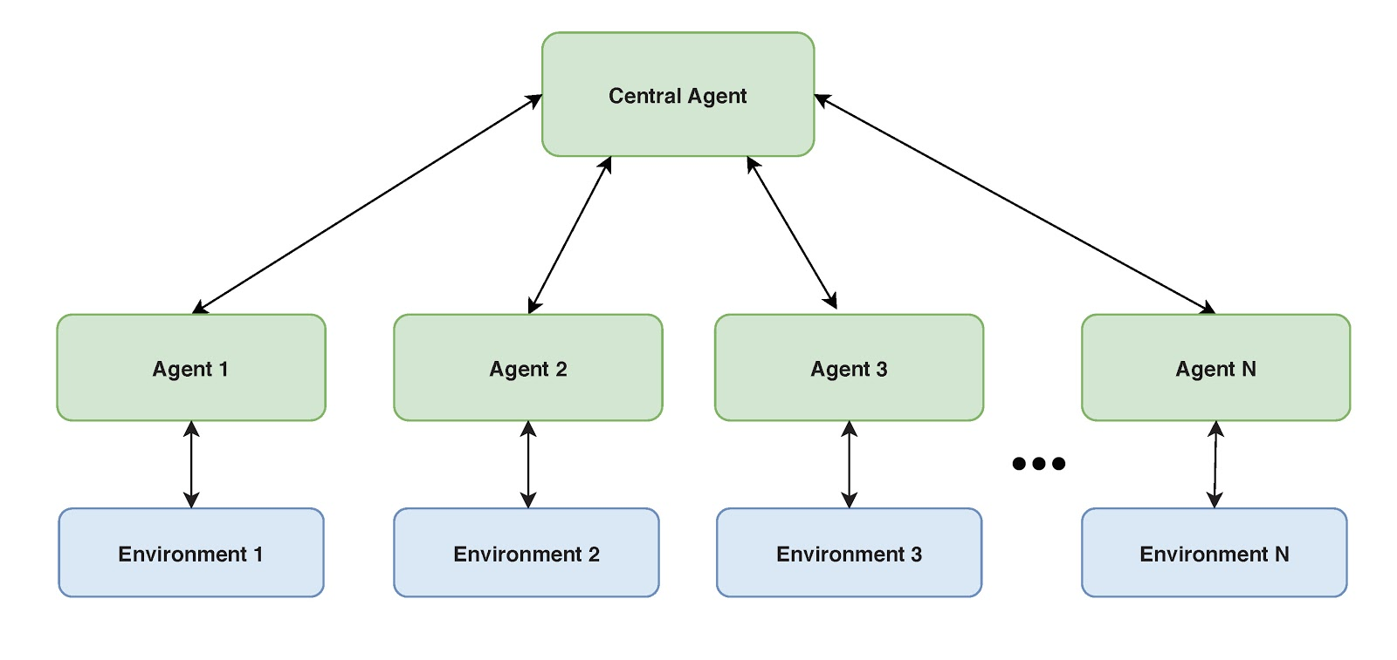
Training A3C with parallel agents
A3C can be trained via parallel agents asynchronously and thus learns more efficiently and quickly (by several order of magnitudes)
The agents continually send their local information (e.g. state, action, and reward) to the central agent which aggregates all the information and updates a single learning model.
The model is populated to all agents asynchronously

Slide 12
Key metrics: Learning rate
The amount that the weights are updated during training is referred to as the “learning rate”. It controls how quickly or slowly a neural network model learns a problem
During training, the backpropagation of error estimates the amount of error for which the weights of a node in the network are responsible. Instead of updating the weight with the full amount it is scaled by the learning rate
For example a learning rate of 0.1 means that weights in the network are updated 0.1 * (estimated weight error)
Notes:
or 10% of the estimated weight error each time the weights are updated

Slide 13
Key metrics: Loss function
A loss function is used for measuring the discrepancy between the target (expected) output and the computed output, after a training example has propagated through the network
The result of the loss function can be a small value if the value of computed and expected outputs are close

Slide 14
Key metrics: Entropy
We can think of Entropy as a surprising scenario, when an agent is really puzzled. For example when at a particular state a set of large actions with a very close probability can be selected.
Agent should explore other possibilities to get better knowledge of its state-action relationship.
When something surprising happens entropy should increase given that the value of entropy is a negative input to the loss function.
Notes:
This ensures that an agent explores other possibilities and not simply converge quickly on a particular action for a given state.

Slide 15
CNO goals for UC2 (Smart + Remote Media Production)
The goal is to maximize the Quality of Experience (QoE) perceived by the user
To achieve the above goal we follow two key objectives:
Decrease packet drop by appropriately selecting the video quality level according to current network condition
Change video quality with smoothness. In other words, jumping from a very high video quality (bitrate) level to a very low one tends to be minimized

Slide 16
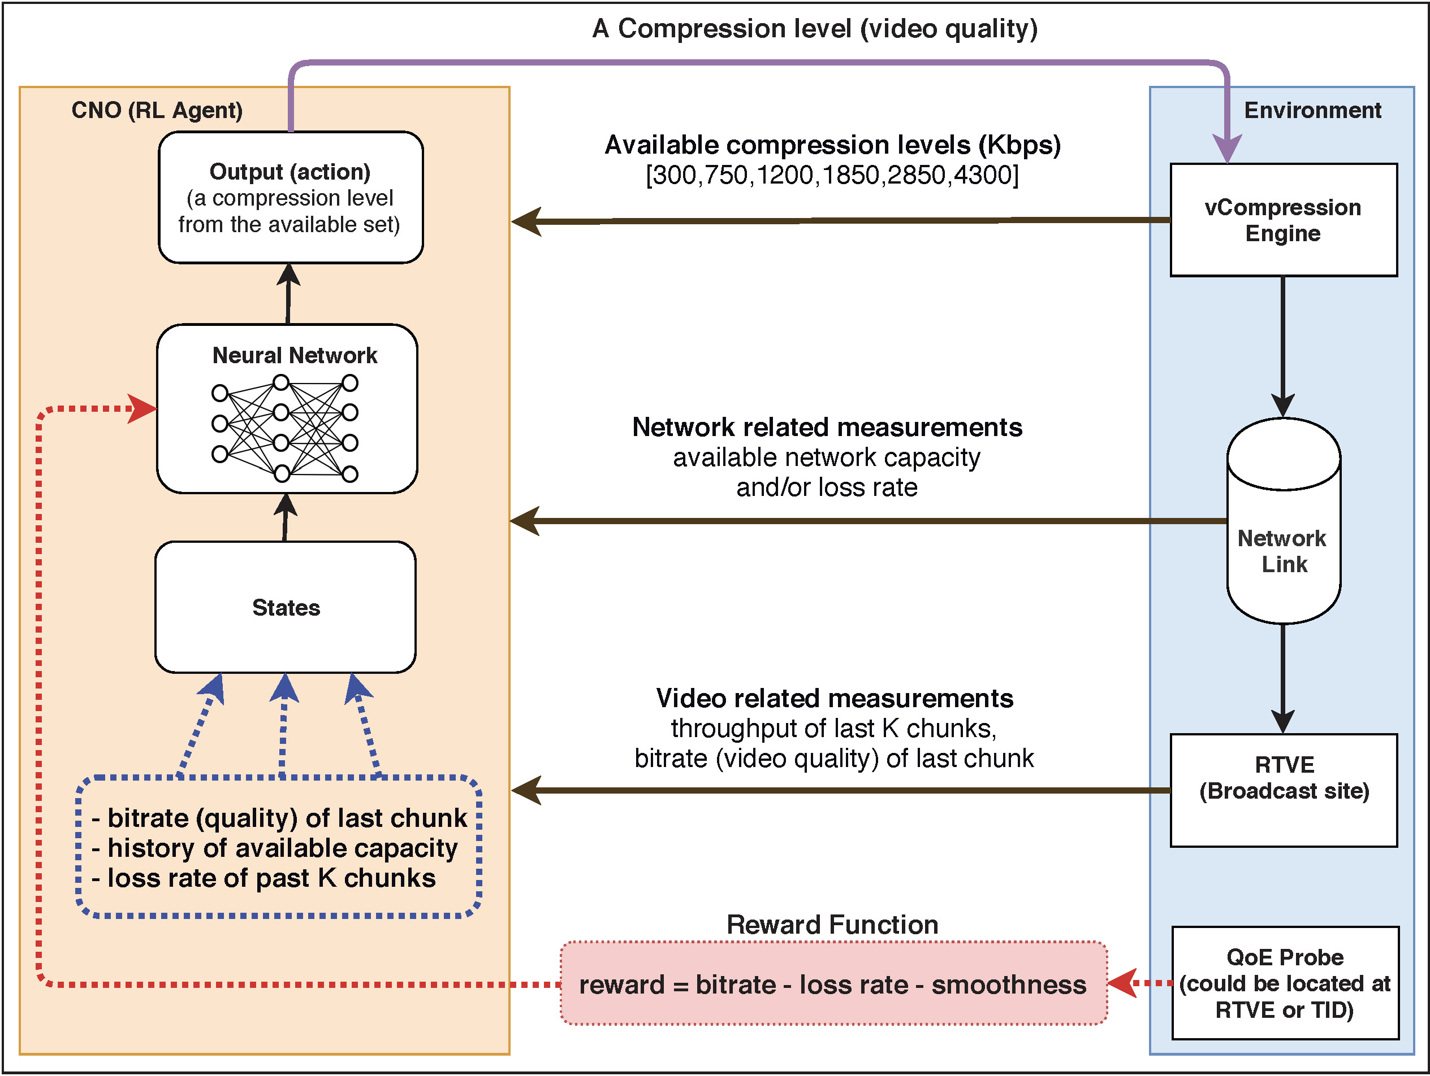
CNO design for UC2
State:
Bitrate (video quality) of last chunk
History of available network capacity
Lossrate incurred for past K chunks
Action:
Video quality for the next chunk
Reward:
Bitrate – α (lossrate) – β (smoothness)

Slide 17
No more theory ☺
Time to get your hands dirty with code
CNO source code is available with the following link:
https://github.com/mkheirkhah/5gmedia/tree/deployed/cno

